Slide 1

Storage Technologies
Telerik Software Academy
academy.telerik.com
Drive Partitioning
Borislav Varadinov
Marian Marinov
System Administrator
CEO of 1H Ltd.
bobi@itp.bg
mm@1h.com

Slide 2

Table of Contents
Disk Structure
Partitions
MBR
GPT
Partition Table

Slide 3

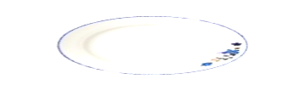



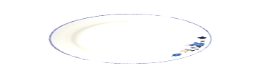
Disk Structure
Бисерите в курса по ОС:
"Все едно се редуват: чиния, вилица; чиния, вилица; чиния, вилица; а между две чинии има ... двойна вилица!"
Вилица
Чиния
Двойна Вилица!?!?!?

Slide 4
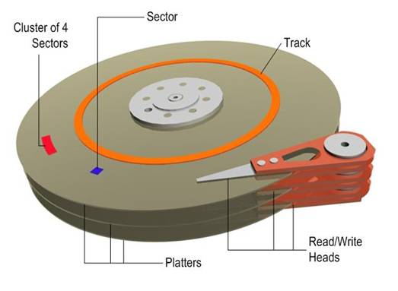
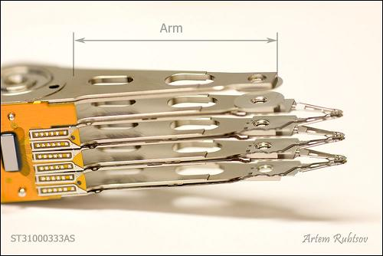
Disk Structure

Slide 5
What is a Partition and why we need partitions?
Partitions are collections of contiguous sectors on a storage device. Each partitions is separated part from other portions of the disk.
Dividing a hard disk drive into multiple logical storage units
Partitions are treated by the operating system as an independent storage area
Can be used for separation of OS data and application/user data.
Each partitions has own file system
Notes:
Drive Partition is the act of dividing a hard disk drive into multiple logical storage units referred to as partitions, to treat one physical disk drive as if it were multiple disks

Slide 6
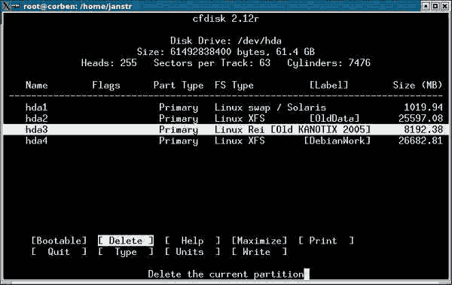
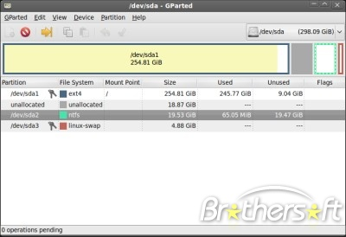
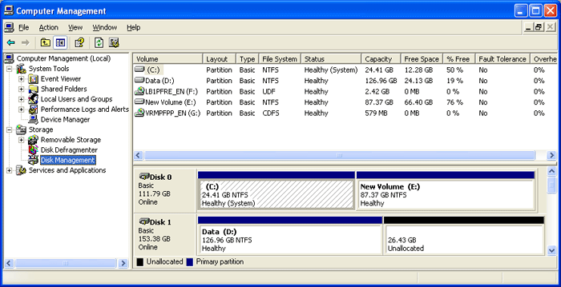
Partitions Editors (Tools)

Slide 7
Master Boot Record (MBR)
The master boot record is created when a hard drive is partitioned but is not located within a partition. The master boot record is located on the first sector of a disk
A master boot record consists of three major pieces:
  Master boot codе
  Master partition table
  Disk signature (optional)

Slide 8
MBR Partition Table
The partition table consists of four entries that define the locations of as many as four primary partitions on a disk
Records a partition’s type
Stores a partition’s starting sector and size
it is always located on the same disk as the partition

Slide 9
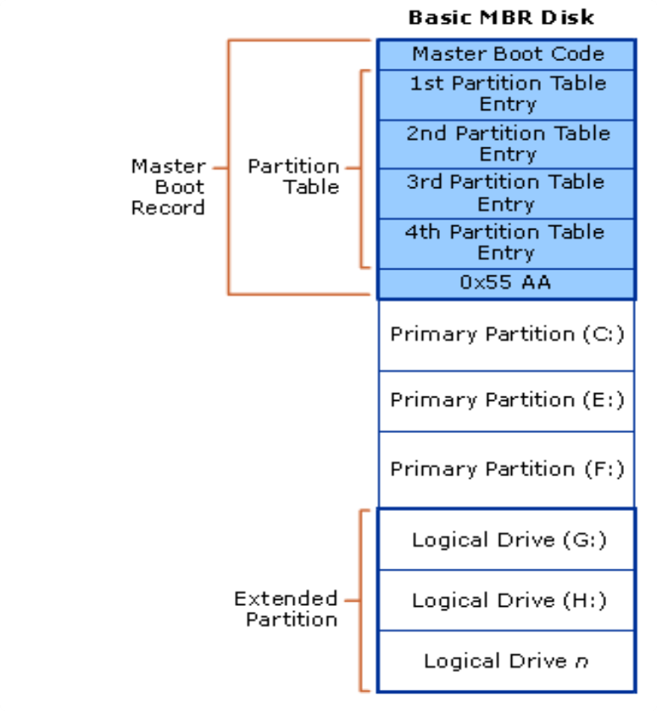
MBR Partitions Scheme

Slide 10
Primary and Extended
  Primary Partitions
    Limited to only four per physical drive
    Required for a system to boot
  Extended Partition
    There is only one per physical drive
    Subdivided into a number of logical drives
    The number of logical drives is limited only by the amount of available disk space
Notes:
The system must mark one primary partition of the primary disk as active (bootable). The Windows code in the MBR loads the code stored in the first sector of the active partition (the system volume) into memory and then transfers control to that code.

Slide 11
GPT

Slide 12
Drive Partitioning
http://academy.telerik.com

Slide 13




Free Trainings @ Telerik Academy
"Web Design with HTML 5, CSS 3 and JavaScript" course @ Telerik Academy
    html5course.telerik.com
  Telerik Software Academy
    academy.telerik.com
  Telerik Academy @ Facebook
    facebook.com/TelerikAcademy
  Telerik Software Academy Forums
    forums.academy.telerik.com

